Slide 1


University of Illinois REU Introduction to Matlab
Compiled by Erik Huemiller
This is designed to provide guided self learning of using matlab for analysis and plotting of data. The self guided part is to enable you to go back later in the summer and relearn/refresh your matlab knowledge on your own.
One big frustration is when an error happens that is syntax related. If this happens asking the TA is a good thing to do.

Slide 2
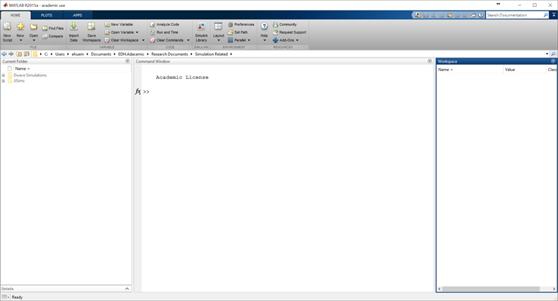
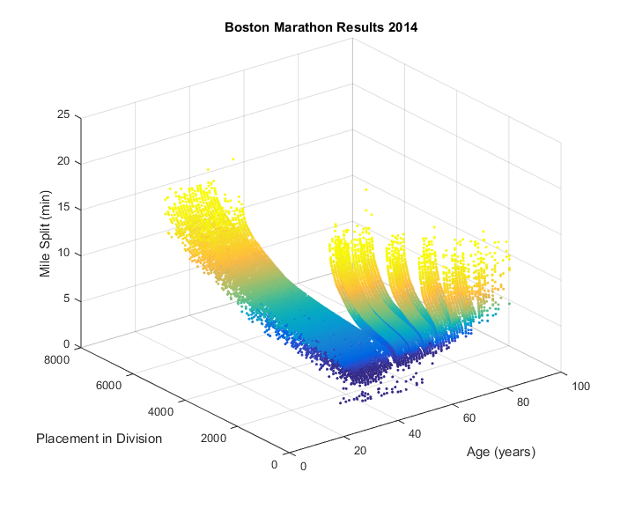
Goals for the REU Crash Course
Where do I type?
Start With
Matlab loaded on a computer
No prior experience with Matlab
End with the ability to
Operate in the Matlab Environment
Create and Import data to visualize it in plots
Fit a model to the data and analyze the error
Plot Master

Slide 3
Resources if you get stuck
Matlab Documentation
Easiest to find through a Google search of “Matlab + command”
There is example code with an explanation of most commands
Links to similar commands are listed at the bottom of the page
BYU Intro to Matlab
Loosely used as an outline for this crash course
PDF with less explicit cross references than the online material
Weitzman Institute
PDF and PPT lectures with slides and example code
Slow moving course designed for people that have never coded before.
Email grad student mentor with questions
Slower response, but can give individual feedback
Can meet up in person to work through a tough problem
Easiest way to find answers about syntax problems or unknown errors

Slide 4
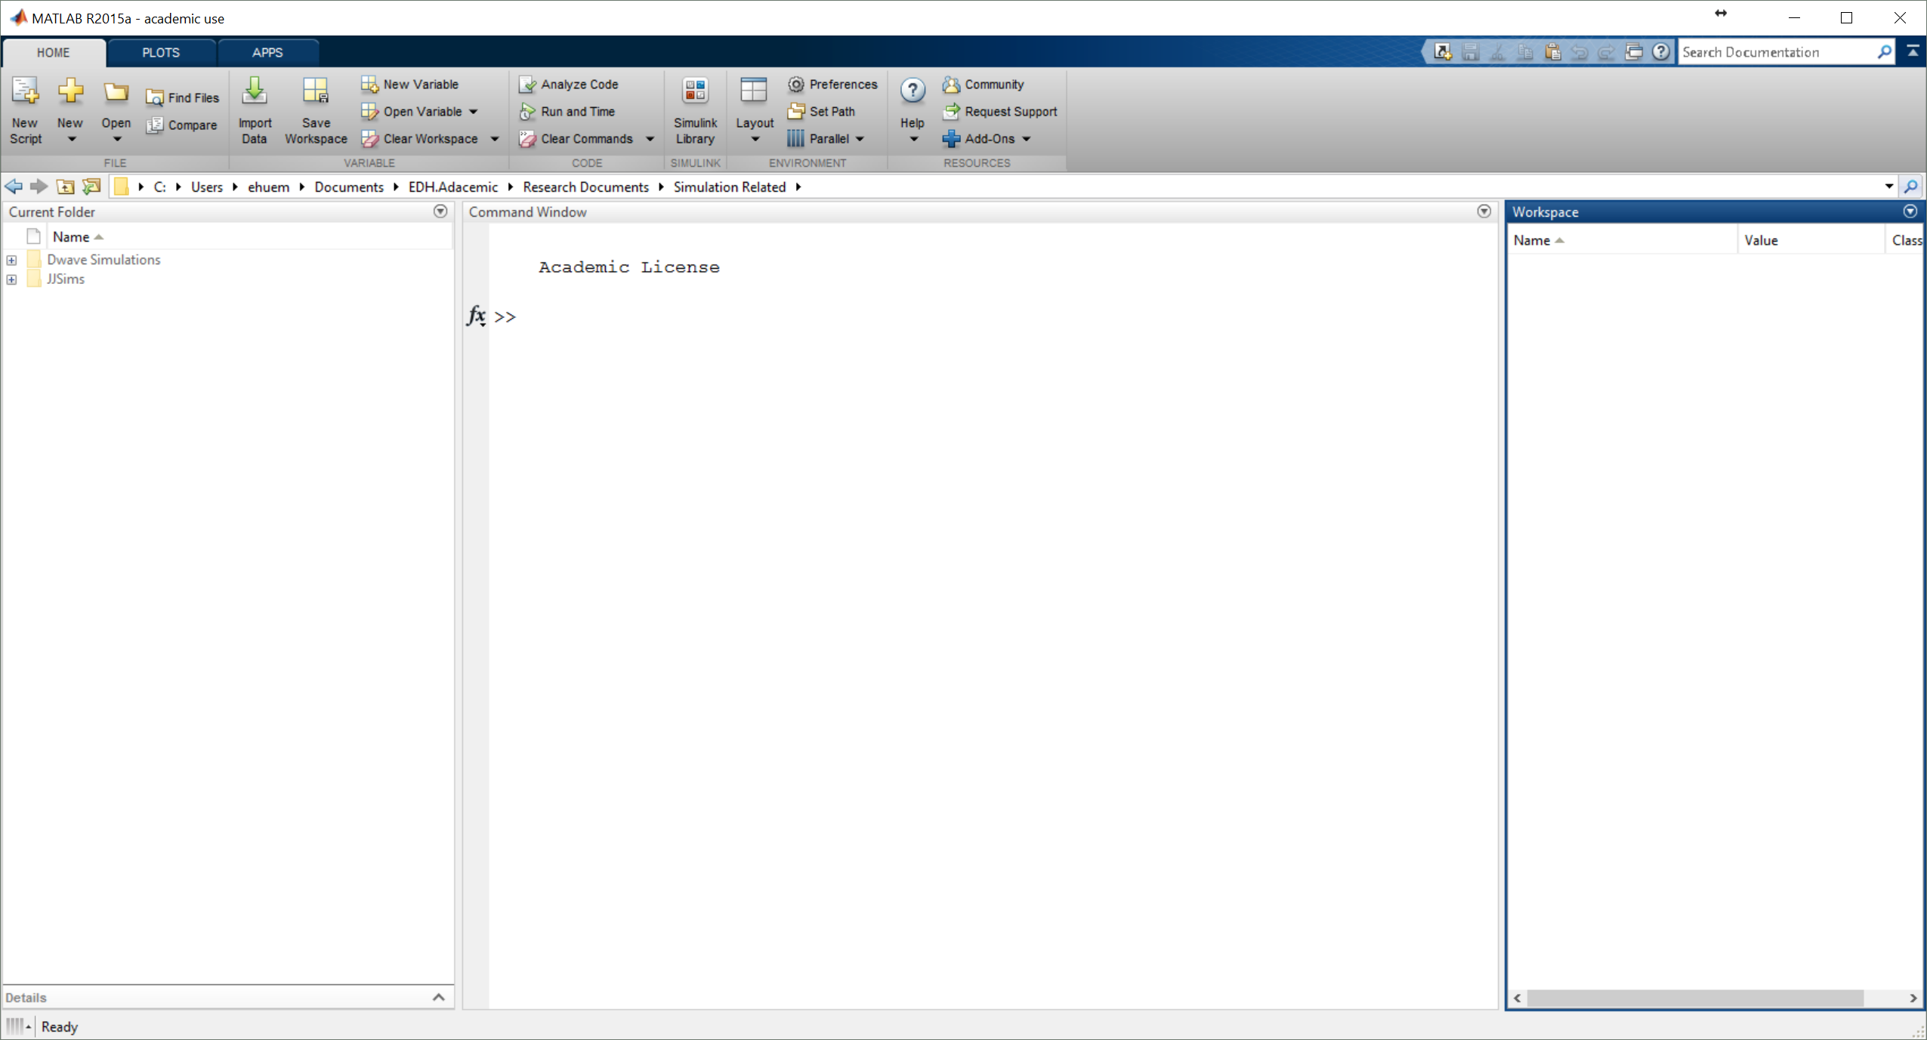
When you open Matlab
Tools for Running Program
Saving, Running, Changing Preferences
This is also wthe GUI for plots and apps
Current Folder
This is where you can find your programs
Command Window
This is where you enter Commands
It is also where the output is displayed
Workspace
This shows variables you have made

Slide 5


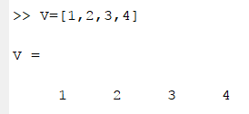
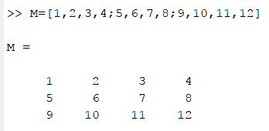
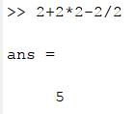
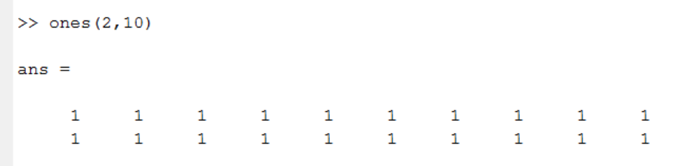
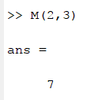
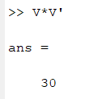
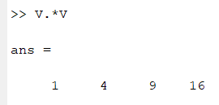
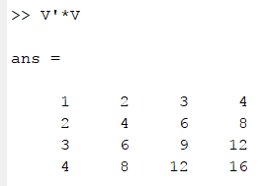

Playing with Variables in Matlab
Some things to try
Display a string of words
Using it as a calculator (+, -, *, /)
Create a variable (=)
Create a vector and a matrix
Taking the transpose of a matrix (‘)
Create a matrix of ones or zeros
Accessing an element of a matrix
Matrix multiplication (* vs .*)
What does adding a “;” at the end of a line do?
What do different clearing commands do (like clear, clc, clear all)?
What happens if you take the sin or cosine of a variable/vector/matrix?
When you do not specify an output variable, MATLAB uses the variable ans, short for answer, to store the results of your calculation.

Slide 6
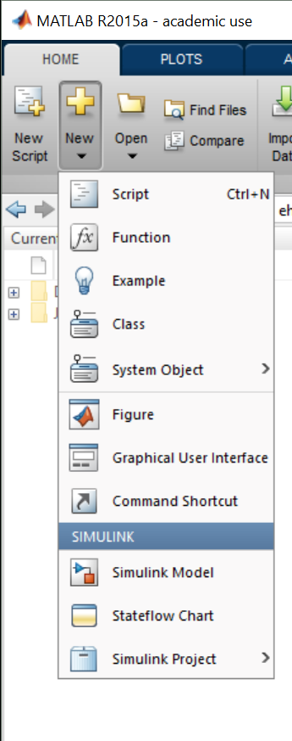
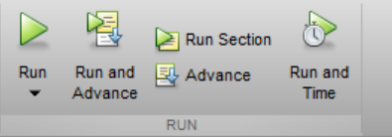
.m files and writing programs
You can write Matlab code into a file and save it as a .m file. This makes it easier to write and debut larger programs without using the command line. The interface in the script editor also makes it easier to write clean and functional code.
Open a new file here
Try to write a program that will create a variable but not output it yet, print the phrase “Hello World” in the command window and then print the value of the variable squared.
When you have written it, save it in the home directory and hit the run button.
Some notes about file names
Stick with Alpha Numeric
No Spaces allowed (use underscore instead for spaces)
Some notes about Variable Names
Try to make them descriptive in the program
Keep them short so that its easier to type them without mistakes
No spaces allowed (use underscore instead for spaces)

Slide 7


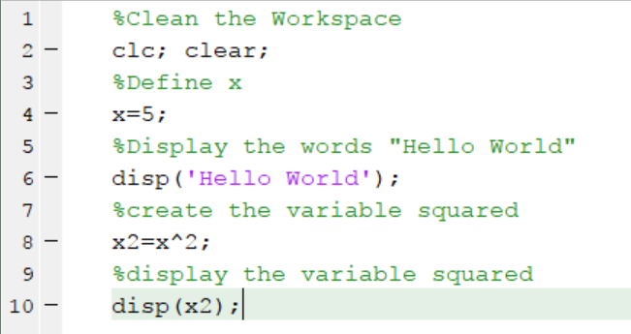
Here is what mine looks like
The output
There are also some variables in the workspace that are left over from the program.
The program
By Placing a “%” in a line it will prevent Matlab from running the rest of the line. This can be useful for leaving comments or explanations of what your program does in case someone else will want/need to use it in the future.

Slide 8

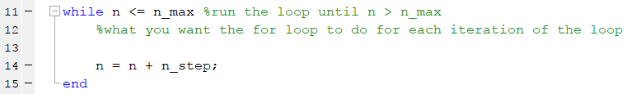
Writing Programs with Loops
For Loops
The loop runs for values in a range dictated by the input
While Loops
The Loop runs while an inequality is satisfied.
Be careful of factors of 1 in this kind of loop.
Try to write a program that sums the first 100 integers using a for loop. Can you make it only count the 10s from 1 to 100?

Slide 9
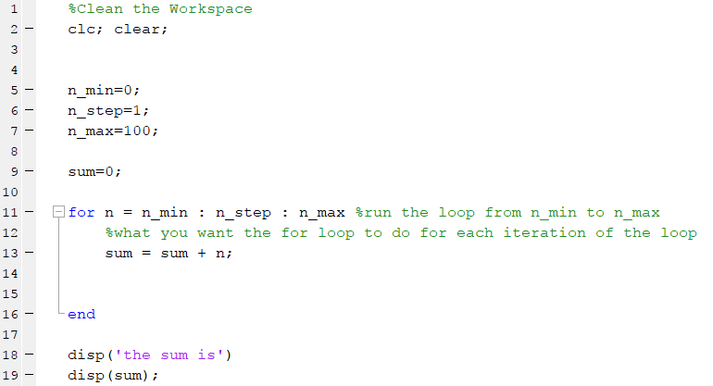

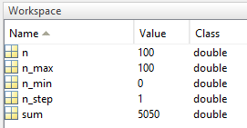
Here is what my for loop looks like 1 to 100 in steps of 1
Output
.m file

Slide 10


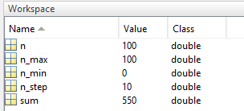
Here is what my for loop looks like 1 to 100 in steps of 10
Output
.m file

Slide 11
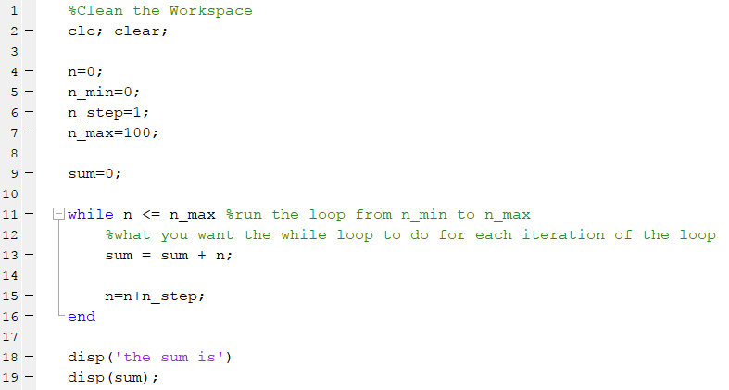

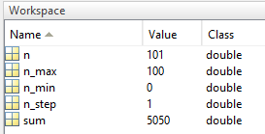
Here is what my while loop looks like 1 to 100 in steps of 1
Output
.m file

Slide 12
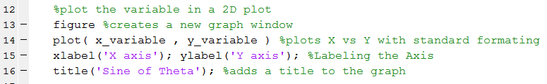
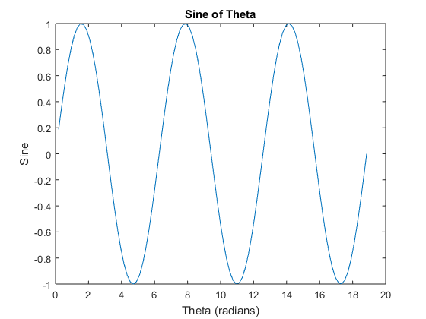
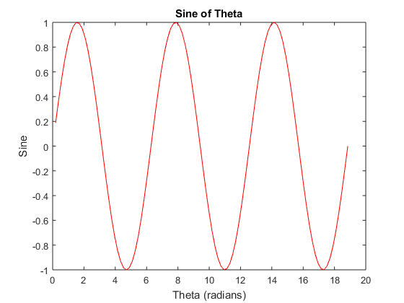
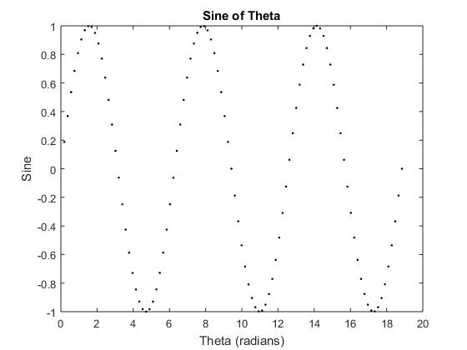
Plotting in 2D and 3D
In Code plotting Order
Plot two variables that are the same length
Add formatting after the second variable if you want
Add labels and a title in the next line
Try to write a program that makes two vectors of equal length (theta, sine) that are 100 points long and are the first 3 periods of a sine function.
Then try to plot them on a 2D plot. It should include axis labels and a title like in the examples (on the right)
Try to change the line to red. Try to change the line to black dots.

Slide 13

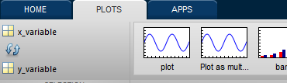
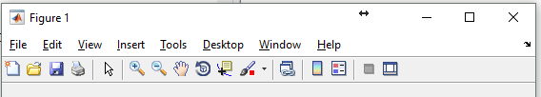
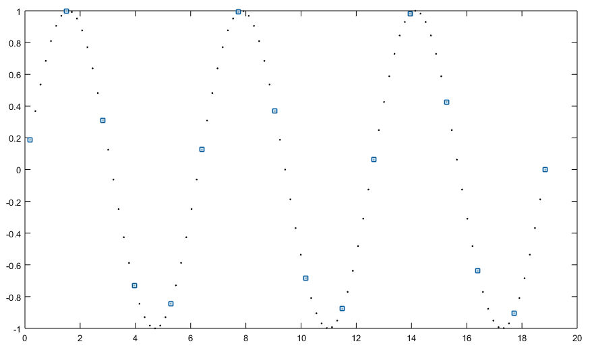
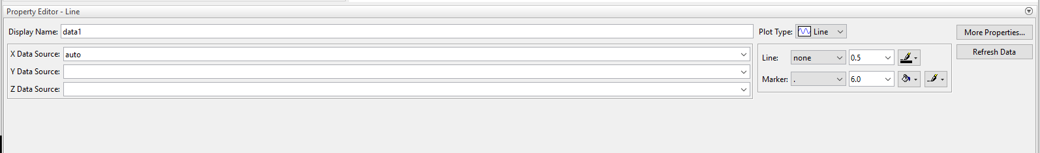
Plotting in 2D and 3D
Using the GUI to plot graphs
Select the variable you want to plot
Select X then Y for plotting 2D plots
Click on the type of plot you want to use
Open Plot Tools and Dock Figure
Select parts of the graph to configure them
Use the “edit plot” curser to select parts of the plot
Blue squares should show up on whatever part is selected for formatting (figure, plot, data)
Use the Property Editor to edit the figure
Try to replicate the graphs from the previous section (slide 12) using the Matlab plotting GUI

Slide 14
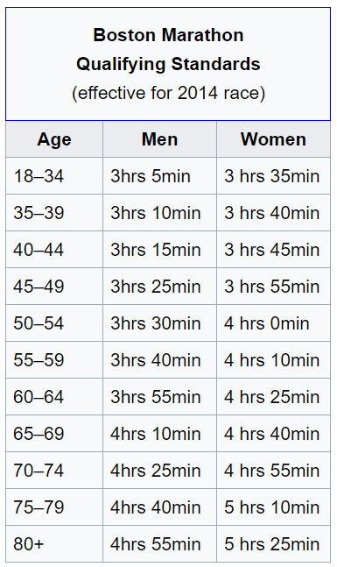
2014 Boston Marathon Data
As the last step, we will explore different plotting functions using some test data. The test data set is the 2014 Boston Marathon Results. The original data can be found on Git Hub here, but a cleaner version is in the Matlab Intro Folder.
Explanation of Data Labels
Age – Runner’s Age
Bib – Runners Bib Number (w# is for wheel chair athletes)
Divisionplace – Place in their division (age, gender, mobility)
City – City of Origin
Country – Country of Residence
Ctz - Citizenship
Gender – Male or Female
Genderplace – Overall Place for their Gender
Halftime - Half Marathon Time
Milepace – Average Mile time for the full marathon
Name – Runner’s Name
Officialtime – Full Marathon Time (26.2 miles)
Overallplace – What place did they come in
State – State of Residence
Time[X]k – split at X kilometers through the race

Slide 15
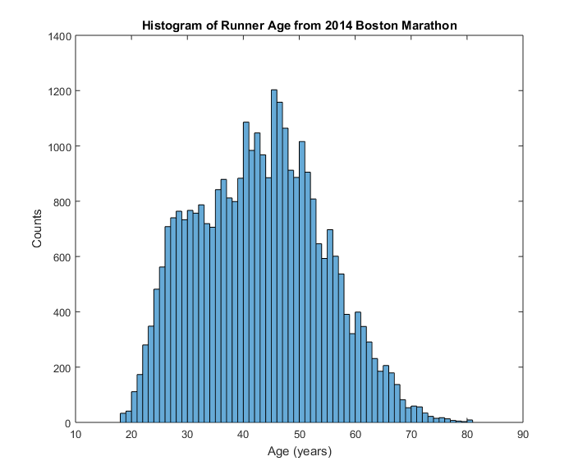
2014 Boston Marathon Data
As the last step, we will explore different plotting functions using some test data. The test data set is the 2014 Boston Marathon Results. The original data can be found on Git Hub here, but a cleaner version is in the Matlab Intro Folder.
Try to import the Boston Marathon results into Matlab and make some plots that provide some insight into the results of the Boston Marathon. Here are some examples to get you thinking

Slide 16
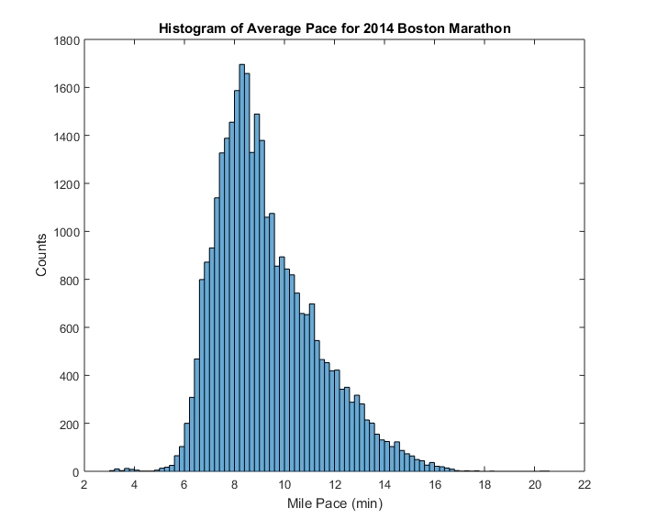
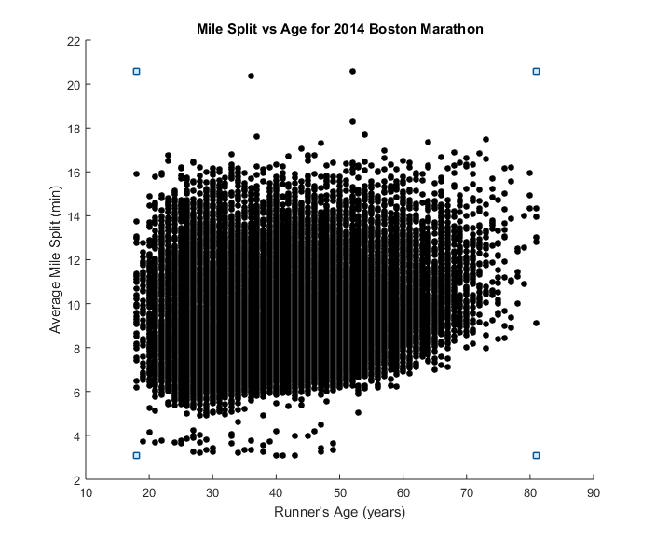
2014 Boston Marathon Data
Some Example Graphs
What are these outliers due to?

